Slide 1
SOCIAL WORLD
TEAM NAME:-
STAR TECHIES
DEVELOP BY:-
ARVIND DHAGE
SUSHANT NAMURTE

Slide 2
INTRODUCTION
Welcome to Social World, the ultimate platform for connecting, engaging, and thriving in the digital social sphere. In an where connectivity transcends boundaries and interactions shape our everyday lives, Social World emerges as a beacon of innovation, offering a dynamic space where individuals, communities, and cultures converge. In today's fast-paced world, social networking has become more than just a means of communication; it's a fundamental aspect of our identity and expression. With Social World, we aim to revolutionize the way people connect, share, and collaborate, fostering meaningful relationships and empowering users to explore diverse perspectives, interests, and experiences.

Slide 3
PROBLEM STATEMENT
Existing social networking platforms lack authenticity and meaningful interactions.
Users encounter irrelevant content and struggle to find communities aligned with their interests.
Privacy concerns and issues surrounding misinformation and online harassment undermine trust.
There is a need for a platform prioritizing authenticity, inclusivity, and user empowerment.
Social World aims to address these shortcomings and redefine the social networking experience.

Slide 4
COMPARISONS
NORMAL APP
Privacy Concerns and Data Breaches.
Limited Accessibility
Privacy Concerns
Device Dependency
Lack of Interactivity
SOCIAL WORLD
Easy To Use
Authenticity and Community Building
No Privacy Concerns
Device Independency
Fully Interactivity

Slide 5
TECH STACK
FRONTEND:- XML (Extensible Markup Language).
BACKEND:- KOTLIN.
DATABASE:- FIREBASE.

Slide 6
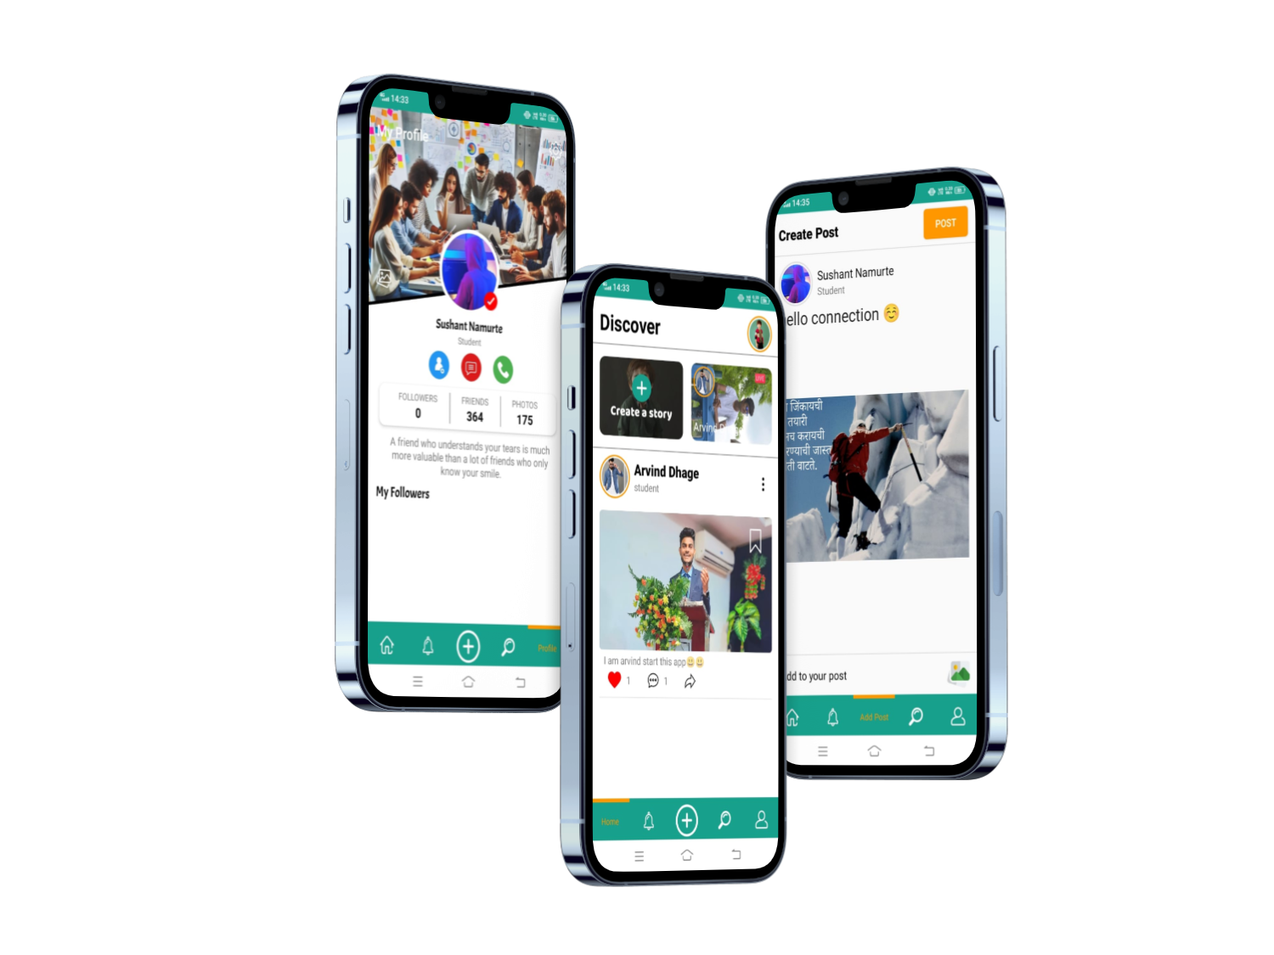
FINAL PROJECT

Slide 7
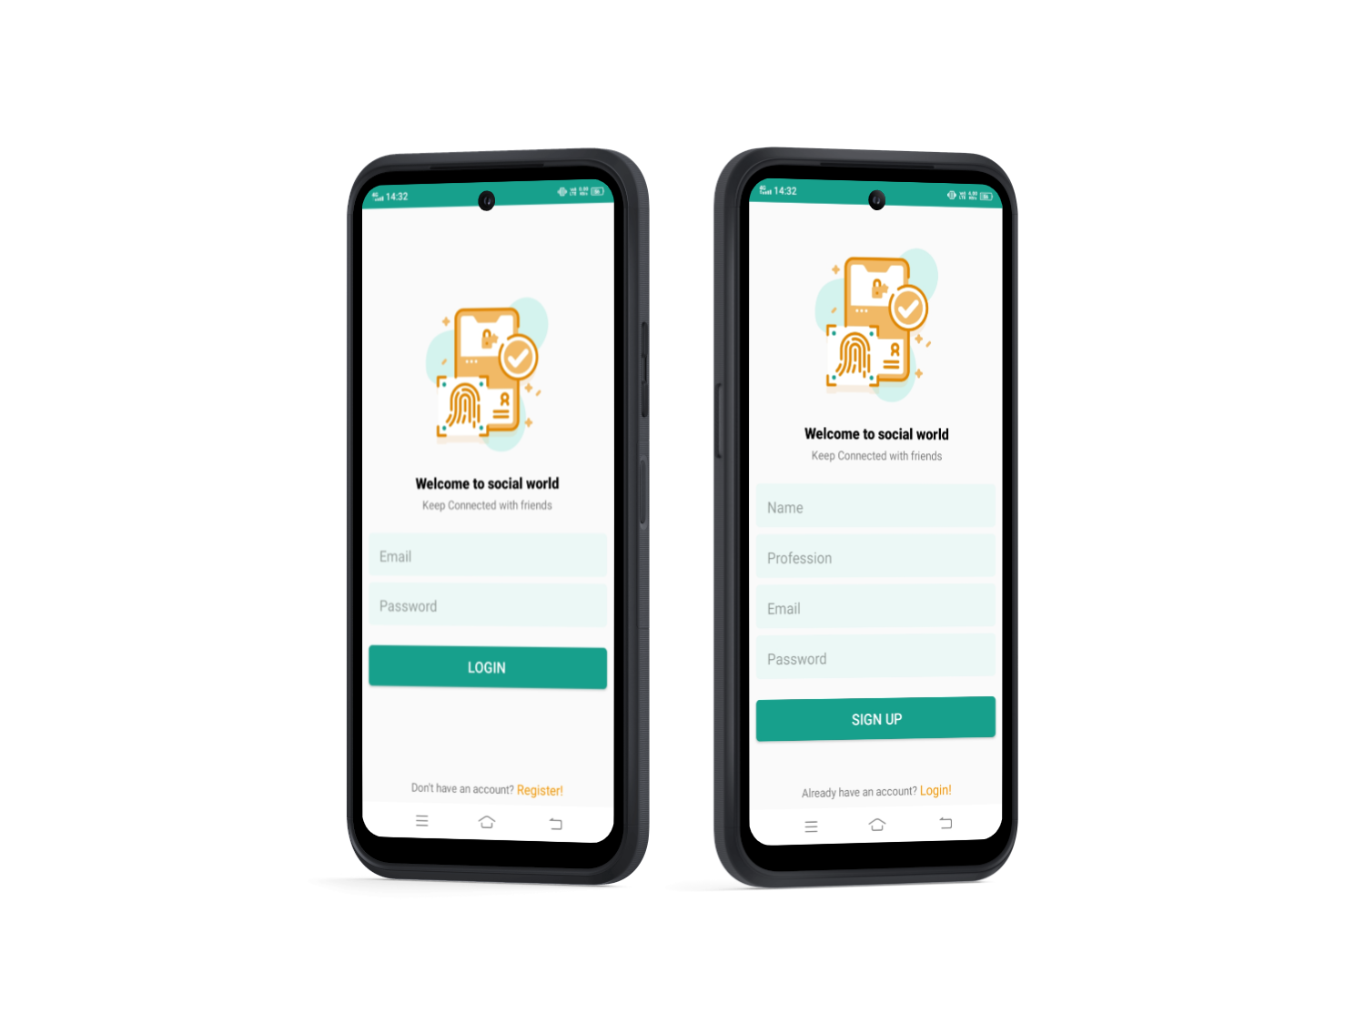
REGISTRATION PAGE

Slide 8
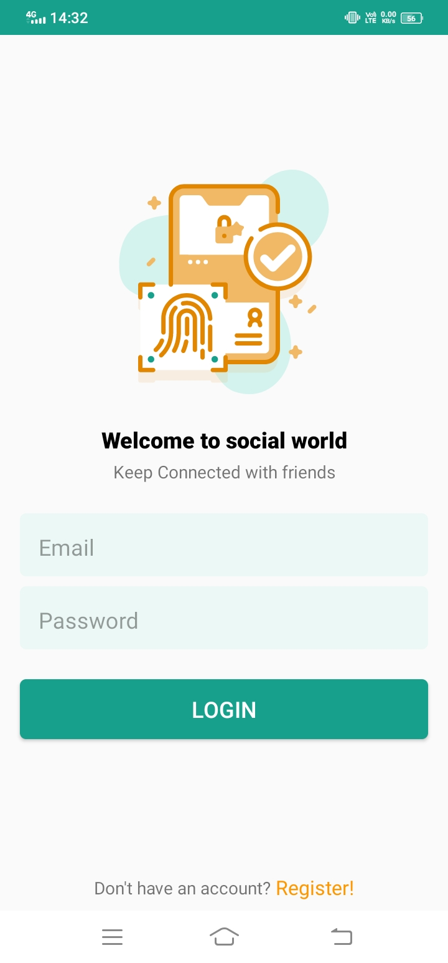
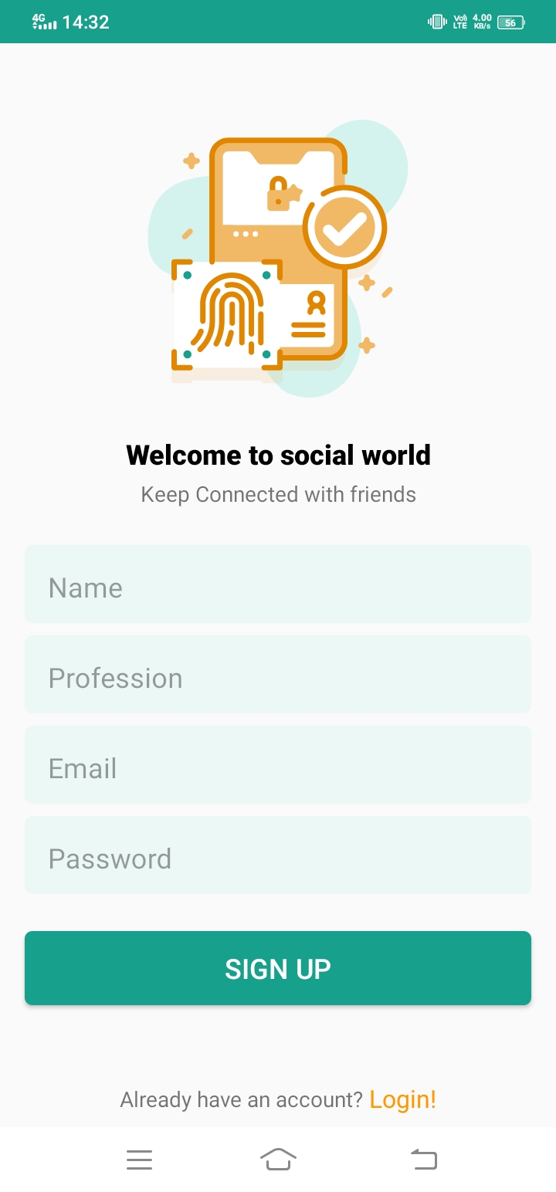
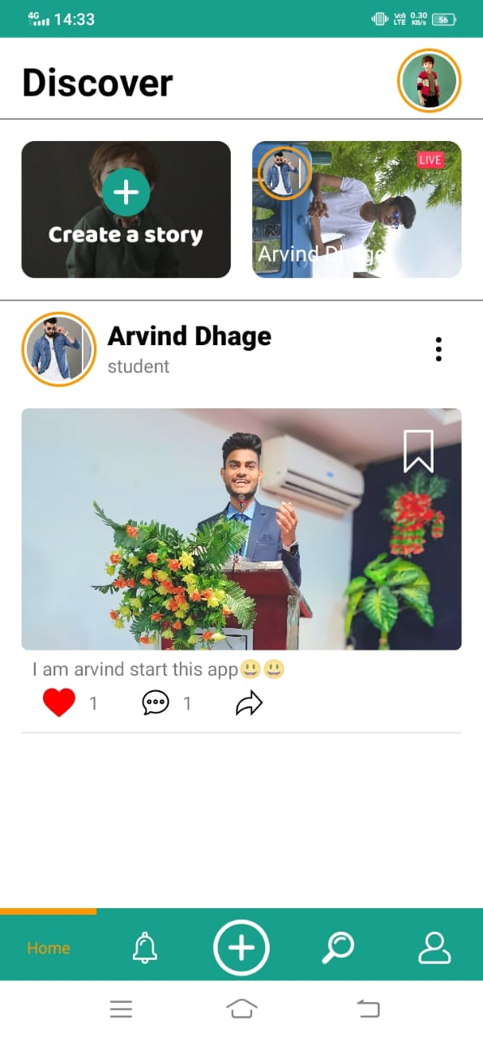
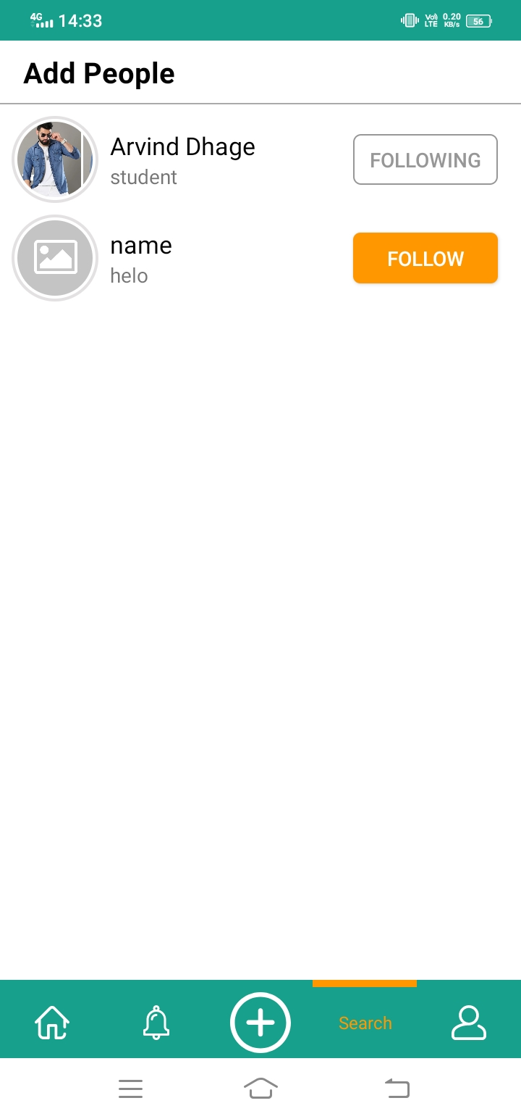
PAGES

Slide 9
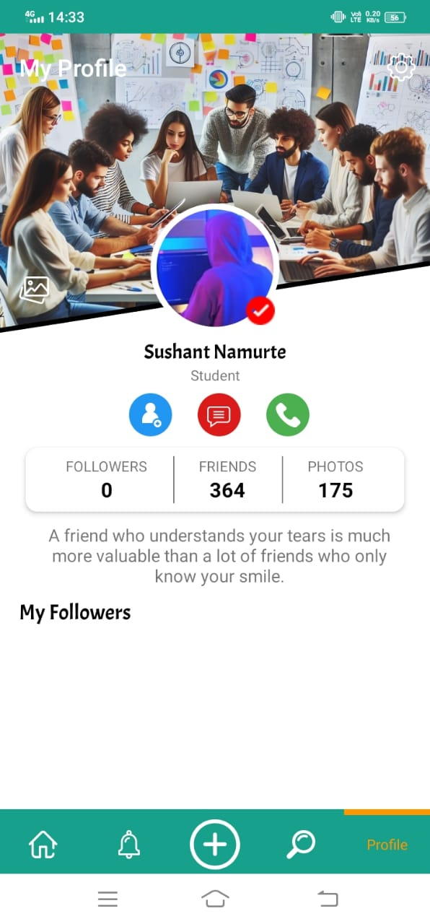
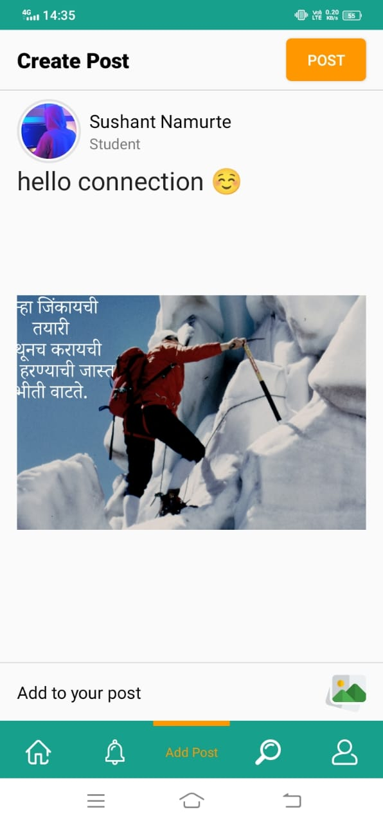
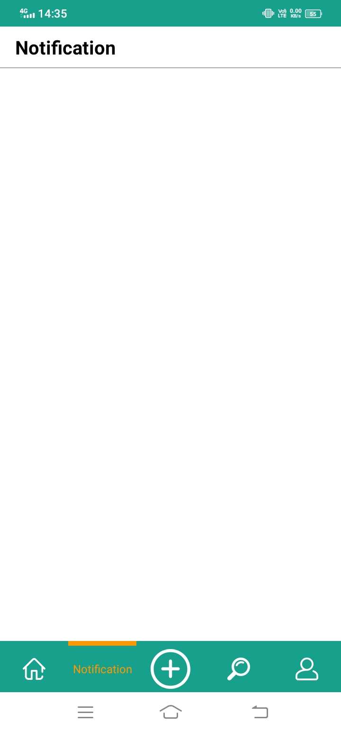
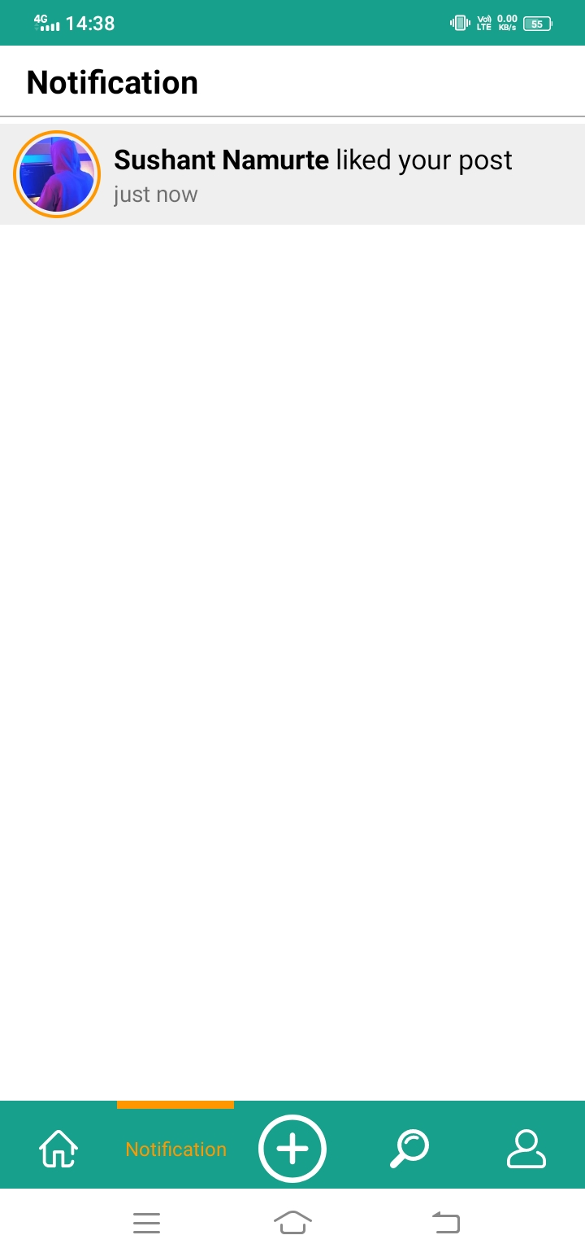
PAGES

Slide 10
Thank You!

